Slide 1
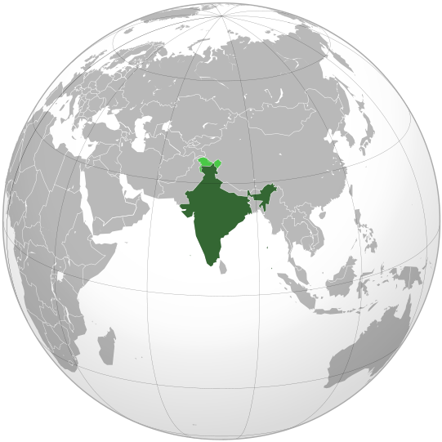
CHEM CONNECTIONS (INDIA)
YOUR EXTENDED ARM IN ASIA . . .

Slide 2
OVERVIEW oF INDIAN ECONOMY
GDP USD 2600 billion, growth rate > 7%
Population 1.32 billion, median age : 26 years, strong workforce
Democratic country, independent judiciary
Economic liberalization started in 1991,
gradual reduction in custom duties from 75%
to 5-10%
Large scale infrastructural development
Emerging economy, difficult to ignore.
The center of gravity is shifting eastwards
and India will be one of the motor forces in
globalization

Slide 3
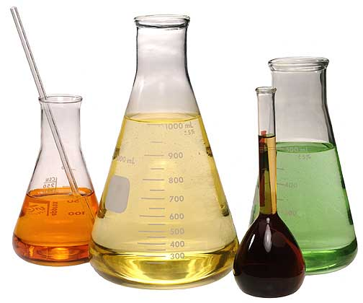
INDIAN CHEMICAL INDUSTRY
Valued at US$ 175 Bn. (expected to be US$ 230 Bn., contributes to 13% of the GDP.
One of the fastest growing sectors of Indian economy, growing at more than 15%.
Fragmented and dispersed industry - multi product and multi faceted.
Focus on cost efficient production by employing latest technologies.
Large players in bulk chemicals along with in fine and specialty chemicals/ingredients.
Manufacturing hub of multinationals for servicing global requirements.
Very strong in specialty and knowledge based products, natural products.
Abundance of technically skilled manpower, minerals,
feed stock and natural products.
Among the top 5 chemical producing countries
of the world. 3rd largest refining capacity.

Slide 4
CHEM CONNECTIONS (INDIA) – AN INTRODUCTION
A part of Reliance tea group, active in tea plantations & processing, chemical manufacturing (Chlorinated Paraffin) and chemical trading.
Established in 2004, today ChemConn is one of it kind in Asian region providing full-fledged sourcing services to international chemicals, polymers, pharma & food ingredients distributors & traders.
Qualified team of 30 people having diverse commercial and technical expertise in sourcing.
Sourcing network of chemicals, polymers, pharma/ food ingredients, minerals & metals from India & Asian countries (China, Korea, Malaysia, Taiwan & Middle East)
Head Office with latest communication infrastructure in central business district of New Delhi (Indian capital) and branch offices in Mumbai (Indian financial hub), Vadodara (center of chemical zone), Bengaluru (Indian silicon valley), Chennai (South India) besides Seoul/Korea & Shanghai/China with regional trading partners.
Ethical business practices. Open & transparent partnership with international distributors and Indian/Asian manufacturers.

Slide 5
OUR STRENGTHS
Experienced promoters; we understand the rapidly changing requirements of international trade with a keen knowledge of what is to be sourced from where.
Qualified team of engineers, chemistry, pharma and commerce graduates, experienced in the same line of business.
Local people, speaking local languages ensure easy communication & closer relationship with manufacturers.
Diverse and close contacts in the Indian chemical industry. Association with several international companies has strengthened our buying power and earned us respect in the industry.
Comprehensive database - directories of manufacturers, import/export statistics, local law books/manuals and industry notifications
Strong logistic arrangements, contacts with shipping companies, freight forwarders, clearing agents, consultants and information providers.

Slide 6
PRODUCTS/CATEGORIES - AT A GLANCE
Pharma & Veterinary | API’s, Intermediates, Formulations, Excipients, Neutraceuticals, Vitamins, Cellulose Derivatives, etc.
Food & Feed | Antioxidants, Preservatives, Stabilizers, Colors, Sweeteners, Vitamins, Soy/Maize products, Minerals, Hydrocolloids, Herbs & Herbal extracts, Spices, oleoresins, Processed Fruit & Vegetables, Flavor & Fragrances, Nuts, feed-meals, Aqua Feeds, etc.
Home & Personal Care | Active Ingredients, Emollients, emulsifiers, Preservatives, Surfactants, Thickeners, Sunscreen, UV absorbers / Filters, Rheology Modifiers, etc.
Flavors & Fragrance | Aroma Chemicals (Cinnamic Aldehyde, Styrallyl Acetate, Benzyl Alcohol, PEA, Styrene Oxide, PTBCHA/OTBCHA), Menthol, Turpentines, etc.
Paint/Ink/ Adhesives | Resins, Binders, Pigments and Dispersions, Additives, Fillers, Solvents, Plasticizers, TiO₂ , Wetting and Dispersing Agent, Thickeners, etc.
Polymers/ Plastics | Resins, Binders, Plasticizers, Fillers, Pigments, Additives, Flame- Retardants, Stabilizers, Processing Aids, Antioxidants, etc.
Minerals & Fillers | Kaolins, Mica/Quartz, Talc, Silicon compounds, Wollastonite, Calcium Carbonate, MnO, Bentonite, Attapulgite, etc.
Agro | Inorganic and organic chemistries such as Magnesium Sulfate, EDTA Chelates, Sulphur, Insecticides, Fungicides, Pesticides, etc.
Others.. | Products for Rubber, Detergents, Textile, Paper, Lubricants, Oil Drilling, water treatment, metalworking, Construction, Glass, Leather, Solvents (IPA, ETAC, GBL), Composites, PU, etc.

Slide 7
BUSINESS PROCESS
Enquiries from SBUs managers of partners
Analyzing India’s strength – products
Understand product & desk search
Suggest SBUs managers & generate enquiries
Finding out competent producers using database and personal contacts
Contact the qualifying producers & introduce the principal
Arrange offer, certificates, specification and samples
Visit producers and undertake plant audit
Commercial negotiations and order placement
Arranging Exclusive Representations
Arrange pre-shipment inspection, if required
Contract Manufacturing
Logistic support & post shipment follow up.

Slide 8
VALUE ADDED SERVICES
Evaluation of suppliers
Plant Audit/inspection
Quality inspection through approved agencies
Single point contact
Combined buying power
One stop sourcing from South East Asian countries like India, China, Korea, Malaysia, Taiwan etc.
Close follow-ups : Arranging offer, samples, pre & post shipments follow up, timely shipment, shipping documents etc.
Claims/disputes settlement/Mediation in settling matters even with financial support
Market study of specific products
Consolidation of different products in single container
Coordinating, updating and educating Indian producers about REACH/regulatory matters
Packaging & stuffing inspection
Promoting partners within the Indian industry, visiting exhibitions, personal meetings
Joint promotional activities along with partners (advertisement in trade journals, joint participation in exhibitions, etc.)
Distribution agreement negotiations
Planning and accompanying partners’ visits to India (even to remotest places)
Co-coordinating with industrial and govt. bodies and keeping partners informed about govt. policies, socio-economic & political situation of the country.
Visiting partners’ offices from time to time to update & exchange views.
Informing partners about new market/products development possibilities
Due diligence of suppliers
Arrange flexible payment terms for exclusive partners after building trust in few transactions

Slide 9
CHEM CONNECTIONS (INDIA) | New Delhi, India | Phone: +91 11 47002421 | Fax: +91 11 47002422 e-mail: info@chemconn.com| Web: www.chemconn.com
International Chemical Distributors we work with
Principals | Turnover (Millions) | Industries Served | Markets served
PARTNERS IN NORTH AMERICA
KG INTERNATIONAL (US) www.kgint.com | $ 50 | Industrial & Specialty Chemicals | Florida and the Caribbean Islands
PARTNERS IN LATAM & SOUTH AMERICA
GRUPO MATHIESEN (Chile) www.grupomathiesen.com | $ 500 | Semi Specialty Chemicals | Latin America (10 countries)
CARBONO QUIMICA (Brazil) www.carbono.com.br | $ 80 | Industrial | Brazil
OXIQUIM S.A. (Chile) www.oxiquim.cl | $ 150 | Industrial, Speciality Chemicals & Polymers | Chile
BASE QUIMICA (Brazil) www.basequimica.com | $ 125 | Industrial Chemicals | Brazil
QUANTIQ (Brazil) www.quantiq.com.br | $ 400 | Bulk & Specialty Chemicals | Brazil
PARTNERS IN ASIA
CHEMFIELD INTERNATIONAL (S. Korea) www.chemfield.co.kr | $ 40 | Bulk & Industrial Chemicals | South Korea
DEPOTCHEM AMGAL (Israel) www.de-am.co.il | $ 120 | Industrial & Specialty Chemicals | Israel
PARTNERS IN CIS
UTS GROUP (Russia) http://utsrus.com/en | $ 200 | Industrial & Food Chemicals | Russia, Ukraine, Belarus, Kazakhstan, Uzbekistan
Notes:
9

Slide 10
CHEM CONNECTIONS (INDIA) | New Delhi, India | Phone: +91 11 47002421 | Fax: +91 11 47002422 e-mail: info@chemconn.com| Web: www.chemconn.com
International Chemical Distributors we work with
Principals | Turnover (Millions) | Industries Served | Markets served
PARTNERS IN MIDDLE EAST & AFRICA
ORKILA HOLDING (Lebanon) www.orkila.com | $ 450 | Specialty Chemicals | Africa and the Middle East
TAMER FRÈRES (Lebanon) www.tamer-group.com | $ 15 | Specialty & Food Chemicals | Lebanon, Middle East, Iran & Africa
PROTEA CHEMICALS (South Africa) www.proteachemicals.co.za | $ 400 | Industrial, Specialty Chemicals & Polymers | South Africa
TARGET FOR CHEMICALS (Egypt) www.target-chemicals.com | $ 50 | Bulk & Specialty Chemicals | Africa and the Middle East
PARTNERS IN EUROPE
GLOBE CHEMICALS (Hamburg) www.globe-chemicals.com | $ 145 | Industrial Chemicals | Latin America & Africa
HSH CHEMIE GmbH (Hamburg) www.hsh-chemie.com | $ 180 | Specialty Chemicals for Food, Pharma, Feed, Coating etc. | CEE (Czech, Poland, Belarus, Bulgaria, Romania, Hungary)
KEYSER & MACKAY (Netherlands) www.keysermackay.com | $ 170 | Paint, Adhesives, Plastics, Ink, etc. | Benelux, Switzerland, Poland, France, Germany, Spain
MEADE-KING, ROBINSON (UK) www.mkr.co.uk | $ 85 | Industrial & Speciality Chemicals | UK
OQEMA AG (Germany) http://oqema.com | $ 850 | Bulk & Specialty Chemicals | DACH, CEE, Lithuania
QUIMIDROGA S.A (Spain) www.quimidroga.com | $ 715 | Industrial Chemicals , Food, Feed & Polymers | Spain, Portugal, Maghreb region

Slide 11
CHEM CONNECTIONS (INDIA) | New Delhi, India | Phone: +91 11 47002421 | Fax: +91 11 47002422 e-mail: info@chemconn.com| Web: www.chemconn.com
International Chemical Distributors we work with
Principals | Turnover (Millions) | Industries Served | Markets served
CARBON GROUP (Ireland) www.carbon.ie | $ 80 | Industrial & Specialty Chemicals | Ireland
EIGENMANN & VERONELLI (Italy) www.eigver.it | $ 240 | Specialty Chemicals, Pharma/ Food/ Feed Ingredients, Industrial | Italy, Turkey, Russia
ELTON GROUP (Greece) www.elton.gr | $ 145 | Industrial & Specialty Chemicals | Greece, Romania, Bulgaria, Serbia & Ukraine, Albania, Turkey
GROLMAN GROUP (Germany) www.grolman-group.com | $ 150 | Paint, Ink, Adhesives, Rubber, Plastics etc. | PAN Europe & Turkey

Slide 12
Thank you for your time
For more information, please visit our website
www.chemconn.com

